Slide 1
Code Contracts and MSDN
Mike Barnett, Manuel Fähndrich, Brian Grunkemeyer, Immo Landwerth, Francesco Logozzo

Slide 2
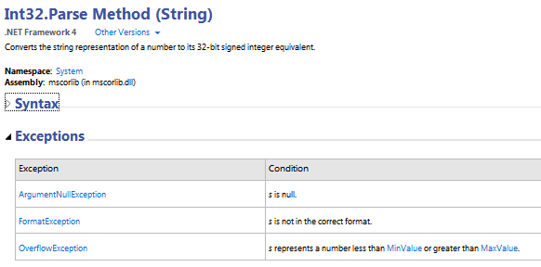
Quick Intro
Method pre- and postconditions that describe the correct behavior of an API
Similar to the Exception table and Return Value section, but more precise and can be used by tools

Slide 3
Demo

Slide 4
Existing Tools
Runtime checking
Each contract is injected as an assertion
Inheritance makes this very powerful
Static checking
Advanced FxCop: feedback at compile time!
Editor extensions
Help “in your face”
Documentation!

Slide 5
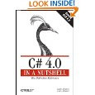
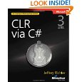

Status
Contract Library: Part of mscorlib since v4
Tools: Available from MSDN since 2009
Over 55,000 downloads
Most active DevLabs project
Internal Use
MSR (e.g., CCI)
Used by some product groups
Retrofitted onto mscorlib and some other BCL assemblies
Integrated into CLR build
Dynamics (X++ integration)
External Use
More than 15 projects (most on CodePlex)
Commercial users
Book Chapters!

Slide 6
CCDoc
/// <summary>
/// Creates a literal expression for the boolean value "b".
/// </summary>
/// <param name="tok">Source context for the literal.</param>
/// <param name="b">Boolean value of the literal.</param>
public LiteralExpr(IToken tok, bool b) : base(tok) {
Contract.Requires(tok != null);
Val = b;
Type = Type.Bool;
}
Enriches the XMLDoc file with extra tags
<member name="M:Microsoft.Boogie.LiteralExpr.#ctor(Microsoft.Boogie.IToken,System.Boolean)">
<summary>Creates a literal expression for the boolean value "b".</summary>
<param name="tok">Source context for the literal.</param>
<param name="b">Boolean value of the literal.</param>
<requires>tok != null</requires>
</member>

Slide 7
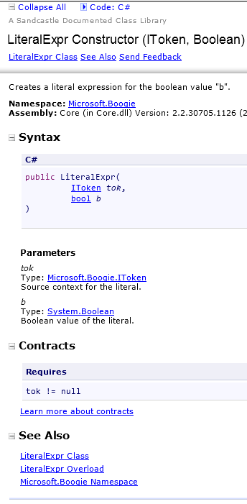
From XML to HTML
Existing Transforms:
IXP
Sandcastle Styles

Slide 8
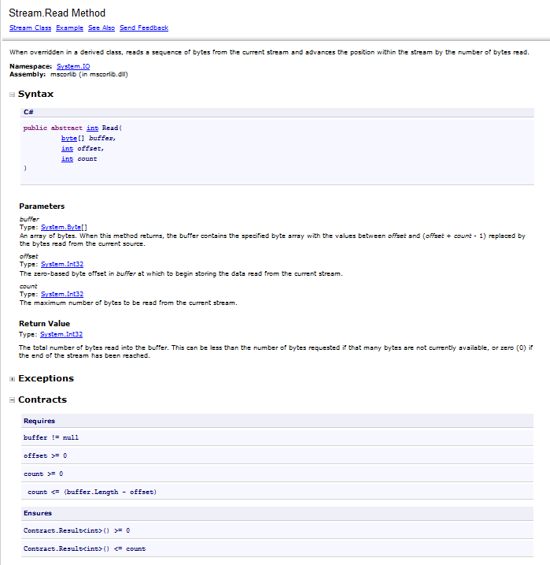
IXP Generated Page
Existing Sections
New Contract Section

Slide 9
Language-specific contracts
Contracts are persisted as IL: they can be rendered in any particular format
public string[] M(int[] xs) {
Contract.Ensures(Contract.Result<string[]>() != null); … }
Could be written in any .NET Language
C#
Contract.Result<string[]>() != null
VB
Neutral
Contract.Result(Of String())() != null
result ≠ null

Slide 10
Other information in contracts
Programmer-specified message
Exception
CCDoc persists both in the XML
public int M(string[] names, int index) {
Contract.Requires(names != null, "The names array must be non-null!");
public int M(string[] names, int index) {
Contract.Requires<ArgumentNullException>(names != null);

Slide 11
Benefits
Programmer
Automatically generates documentation showing intent
API Consumer
Clear, concise, unambiguous
Documentation Writer
Reduced need to reverse engineer code to understand usage
Fewer doc bugs

Slide 12
Build Process
Source Code
CCRef
Contract Assembly
CCDoc
Contract Assembly Source
XMLDoc File
It is all automatic!

Slide 13
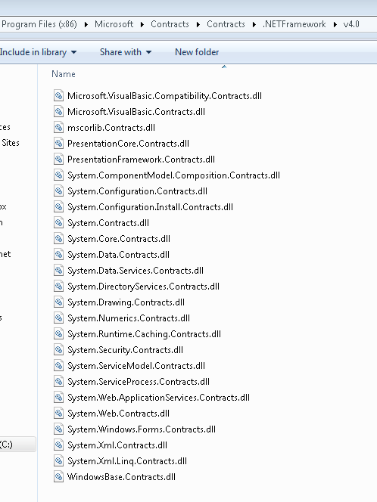
Existing Contract Assemblies
Covers ~4k types and ~55k members
~61 % of the top 1k* APIs are covered
* Usage data taken from ~50k apps, including Phone, Silverlight and desktop

Slide 14
Roadmap
Tools are mature
Support commitment from MSR
Adoption continues — internally and externally
VS Ultimate interested in static checking for Dev12
Roslyn integration provides interactive feedback

Slide 15
Proposal
MSDN adds Contract section to documentation
Low cost
Low risk
Lots of benefits!
IXP has already modified their tools to produce the HTML.
CLR builds already produce input for CCDoc.
Can provide help for other teams.

Slide 16
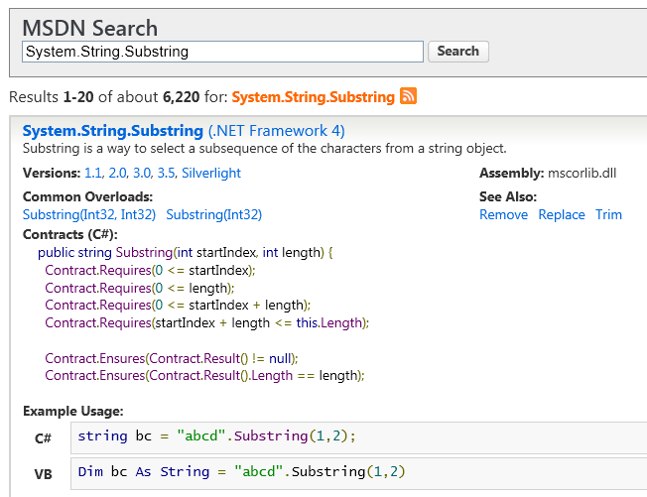
Instant Answer

Slide 17
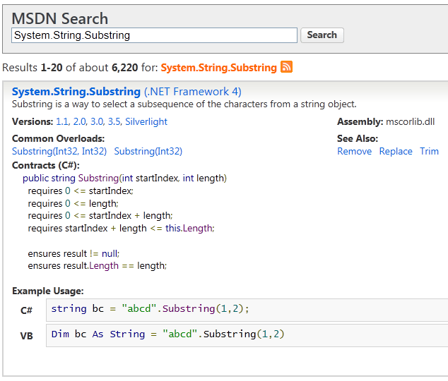
Instant Answer

